Slide 1
CSCIU 210 Computer Organization AKM Jahangir A Majumder, PhD
Fall 2018 - Lecture 21 & 22
October 22, 2018
Note: Some slides are adapted from those used by previous instructors and some slides include figures from the textbook.

Slide 2
Review and Learning Outcomes
We finished our coverage on how to do simple ALU design
Will continue to cover:
Sequential Logic Circuit
S-R Latch
D- Latch
D Flip-Flop
Quiz 4 grades and keys are posted on Blackboard
Mean: 7.95
Median: 8.0
Standard Deviation: 1.43

Slide 3
The Latch Timing Problem (continued)
Consider the following circuit:
Suppose that initially Y = 0.
As long as C = 1, the value of Y continues to change!
The changes are based on the delay present on the loop through the connection from Y back to Y.
This behavior is clearly unacceptable.
Desired behavior: Y changes only once per clock pulse
Y
D
Q
Clock
C
Q
Clock
Y

Slide 4
The Latch Timing Problem (continued)
A solution to the latch timing problem is to break the closed path from Y to Y within the storage element
The commonly-used, path-breaking solutions replace the clocked D-latch with:
a master-slave flip-flop
an edge-triggered flip-flop

Slide 5
Flip-Flops Preview
The Flip-Flop is designed to solve the latch timing problem
Two types of flip-flop
Master-slave flip-flop
Edge-triggered flip-flop
Standard symbols for storage elements

Slide 6
Triggering
When devices react to clock signal
Level triggered
Edge triggered
Rising edge
Falling edge
Rising edge
Falling edge
Clock

Slide 7
Our Implementation
An edge triggered methodology
Typical execution:
read contents of some state elements,
send values through some combinational logic
write results to one or more state elements

Slide 8

Falling-Edge D flip-flop Operation
Output changes only on the falling clock edge

Slide 9


Comparison: D-Latch Operation
Output changes when C is asserted

Slide 10
Storage Element’s Timing Model
Clk
Setup
Hold
D
Q
D
Don’t Care
Don’t Care
Clock-to-Q
Q
Unknown
Setup Time: Input must be stable BEFORE trigger clock edge
Hold Time: Input must REMAIN stable after trigger clock edge
Clock-to-Q time:
Output cannot change instantaneously at the trigger clock edge
Similar to delay in logic gates, two components:
Internal Clock-to-Q
Load dependent Clock-to-Q
Typical for class: 1ns Setup, 0.5ns Hold
Notes:
So far we have been looking at combinational logic, let’s look at the timing characteristic of a storage element.
The storage element you will use is a D type flip-flop trigger on the negative clock edge.
In order for the data to latch into the flip flop correctly, the input must be stable slightly before the falling edge of the clock. This time is called the Setup time.
After the clock edge has arrived, the data must remain stable for a short amount of time AFTER the trigger clock edge. This is called the hold time.
The output cannot change instantaneously at the trigger clock edge. The time it takes for the output to change to its new value after the clock is called the Clock-to-Q time.
Similar to delay in logic gates, the Clock-to-Q time has two components:
(a) The internal Clock-to-Q time: the time it takes the output to change if output load is zero.
(b) And the load dependent Clock-to-Q time.
+2 = 50 min. (Y:30)

Slide 11
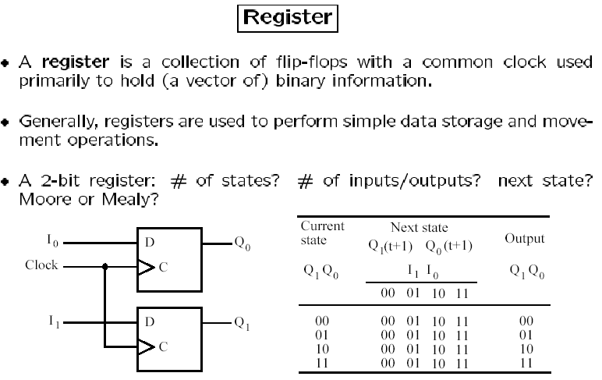
Registers
A register is a collection of flip-flops with a common clock used primarily to hold (a vector of) binary information
Generally, registers are used to perform simple data storage and movement operations.

Slide 12
S-R Latch, D Latch, and D Flip-Flop
R (reset)
Q
S (set)
Q

Slide 13
In-Class Exercise
Assume a falling edge D Flip-Flop is used, based on clock (C) and input signal (D), draw the D-type flip flop output
Repeat the previous problem assuming a rising edge D Flip-Flop is used.

Slide 14
Registers consisting of D Flip-Flop
D₀
D₁
D₂
D₃
D
D
D
D
Q
Q
Q
Q
C
C
C
C
Clock

Slide 15
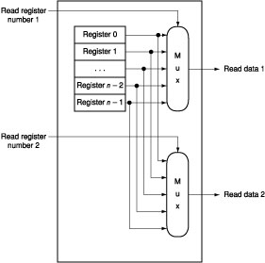
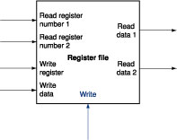
Reading data from Register File
Built using D flip-flops
What is the “Mux” above?

Slide 16
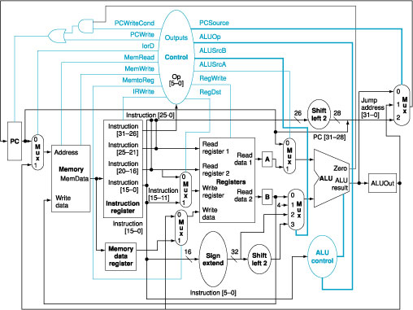
Registers in a MIPS Computer
register
file

